Slide 1
Specialised Commissioning
Improving specialised services for severe intestinal failure adult patients
What will this mean for you?

Slide 2
What are the headlines?
NHS England is responsible for planning and buying specialised services for severe intestinal failure.
Over the past 18 months we’ve been reviewing how these are organised and paid for, to ensure services work well for patients.
Now we have some proposals to make changes to the way these services are commissioned.
The new model of care could mean changes to the care some patients currently receive and where they are treated.
The aim is that patients will see improvements in the services over time.

Slide 3
What is Specialised Commissioning?
Most health services are organised locally by clinical commissioning groups (CCGs) but specialised services are managed directly by NHS England.
These are services which are rare, expensive or only provided at a few hospitals.
146 services are specialised services and commissioned by NHS England.
The budget for specialised services – £16.6 billion in 2017-18 – has increased more rapidly than in other parts of the NHS, but it is under pressure.

Slide 4
Specialised Severe Intestinal Failure services
Severe Intestinal failure (SIF) is a severe condition with inability to absorb sufficient nutrients and/or water required to maintain health. Patients are given nutrients and/or fluids called parenteral nutrition via their blood stream. There are 3 types of intestinal failure:
  Type 1 IF is a more temporary condition where a patient loses intestinal function for less than a month, as the result of illness or while recovering from surgery. Type1 IF is not commissioned by NHS England.
  Type 2 IF is an acute condition and is managed through medical and surgical treatments. This can be a lengthy process with frequent hospital stays and periods at home on Home Parenteral Nutrition (HPN).
  Type 3 IF patients have chronic (long term) IF and are reliant on parenteral nutrition. This is delivered to them at home and can be self-administered in the majority of cases.

Slide 5
Specialised Severe Intestinal Failure services
NHS England are responsible for all in-patient, out-patient and emergency hospital care where the cause of the admission is related to Type 2 and Type 3 SIF.
NHS England also pays for the high cost drugs parenteral nutrition and home parenteral nutrition.
The running costs of the service are roughly £179 million per year.
IF affects both adults and children. These two services are managed separately and this consultation is related to the adult service only.
This review has only looked at specialised adult SIF services, so doesn’t include all the care patients may need.
Specialised commissioning does not include GP care or community care.

Slide 6
Why are we reviewing services?
A clear national plan for the service was not implemented and hence services have developed in an unplanned way over the last decade.
Not all hospitals have teams in place that have expertise in SIF or are not able to offer this 24/7.
Information collected by hospitals suggest variation in quality of care across the country.
We know from feedback that some patients are travelling longer distances to their preferred centre rather than one closer to them.
It was difficult to capture information about the number of patients using the service and how much it was costing hospitals to deliver the service.

Slide 7
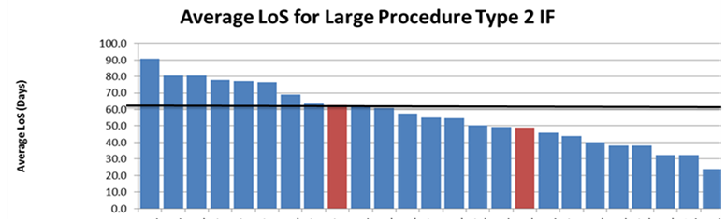
Variation in Care - Length of Stay in Hospital

Slide 8
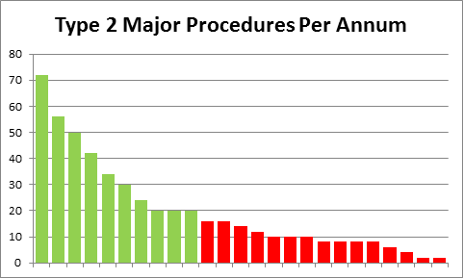
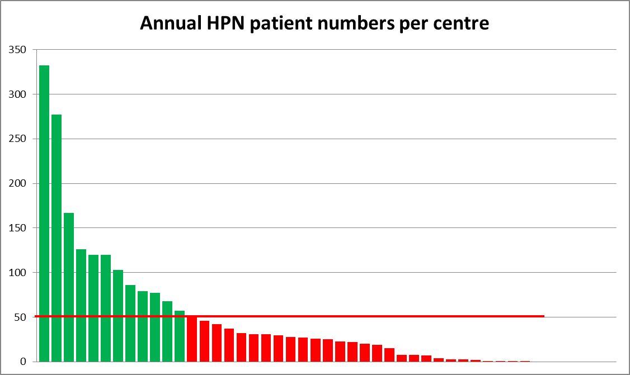
Variation in activity and patient number in current hospitals

Slide 9
What has been learned during the review?
Increasing numbers of people in England are living with SIF.
Feedback from patients and clinicians suggests that services work better for people when hospitals communicate with each other and work together in the best interests of patients.
The national provision of SIF services is currently characterised by a large number of hospitals seeing a small number of patients. This means too many hospitals are performing complex SIF surgery and managing patients on HPN.
Significant variations in availability and access to services in parts of the country due to the organic growth of services rather than planned development .
Long delays in transferring patients to a SIF centre.

Slide 10
What are we proposing to do differently?
We are proposing the following model:
  Integrated SIF Centres: These centres will manage patients who need complex surgery and medical treatment and will provide a clinical service to patients discharged on HPN. Centres will liaise with (usually) independent sector companies who manufacture and deliver the home parenteral nutrition (HPN) for patients.
  SIF Home PN Centres: These centres will not offer complex surgery services but will provide a clinical service to patients discharged from Integrated SIF Centres on HPN. Centres will liaise with (usually) independent sector providers who manufacture and deliver the HPN for patients.
  A networked model of centres: To ensure that hospitals in each region work together so that patients are managed in the right setting to ensure optimal outcomes for patients.

Slide 11


Proposed Model for Adult Services
We want a SIF service that meets the needs of patients from when they are first diagnosed and during their long term treatment and support.
Rather than 45 SIF providers, the recommended future model for SIF Services is Integrated SIF Centres supporting patients with Type 2 and 3 IF and operating as part of a network model with Home PN Centres.
Integrated SIF Centre
Home PN Centre
Operating as a part of network model, underpinned by clinical, quality and service standards and performance monitoring
Manage surgical and HPN patients
MDT manages at least 30 type 2 IF patients per annum
Centres will have at least 2 IF surgeons undertaking at least 20 specialised operations per year
  Quick access to advice and referral pathway to and from linked Integrated IF Centre
  Team manage at least 50 active HPN patients
  Mainly look after IF patients in the local community with some inpatient admissions

Slide 12
What does the new model mean for you?
The new model will introduce new standards to ensure all patients can expect the same high quality care.
The new model means there will be a network of services where integrated centres and the home PN centres work together to coordinate care for patients and share knowledge. For example, they will have standardise clinical guidelines based on best practice.

Slide 13
What will this mean for patients?
There will be fewer hospitals undertaking complex surgery for SIF and fewer hospitals managing patients on HPN.
This will reduce the choice of hospitals where patients can go as new patients to undergo SIF surgical procedures and be managed for HPN.
It may mean that some patients need to go to a different hospital or travel further when they need complex surgery. Patients will be supported throughout any transfers.
However, this may not be the case for many patients as they will either still be cared for at the same hospital or they may still be able to go to another service that is reasonably close to where they live.
You can have confidence that you have access to specialist teams able to offer high quality care and the best outcomes for recovery.
Whichever service is looking after you they will be required to work together to coordinate your care.

Slide 14
Current Number of Hospitals
Proposed Number of Hospitals

Slide 15
Current Hospitals - North
Type 2 Unit | Patient Numbers
Low | <10
Medium | 10-20
High | >20
Type 3 Unit | Patient Numbers
Very Low | <10
Low | 10-50
Medium | 51-100
High | >100

Slide 16
Current Hospitals – Midlands and East

Slide 17
Current Hospitals - London

Slide 18
Current Hospitals - South

Slide 19
How will the plans be funded?
NHS England has committed to provide additional funding of £18.5m in total over the next 5 years (£3.7m per annum from 19/20).
This money will be spent on strengthening the service and setting up a network model.
We will continue to pay for services in the same ways as we do now by tariff and locally negotiated contracts.
In the mean time, we will continue working with providers and pricing colleagues to collect reference costs and develop a new payment approach for 21/23 that reflects efficient costs.
You know those planning and paying for services have invested more in the services and will be measuring how they are working.

Slide 20
Consultation Questions
In what capacity are you responding to this consultation?
In which region are you based?
To what extent do you agree with the plan to have fewer Integrated IF Centres delivering severe intestinal failure care so they have a greater experience, broad range of skills and can offer 24/7 cover?
Do you have comments about our proposal for a reduced number of Integrated IF centres commissioned to undertake complex surgery and expert oversight?
If so, is there anything that you think should be changed?

Slide 21
Consultation Questions Continued
To what extent do you agree with the plan to have fewer Home PN Centres, offering long term care to people living with Type 3 IF?
Do you have any comments about our proposal for reducing the number of Home PN centres to look after the long term care of patients living with type 3 IF?
If so, is there anything that you think should be changed?
Do you think networks of hospitals supporting patients with IF will improve co-ordination of care and communications about such care?
How do you think these plans could promote equality and address health inequalities? Can you state any particular impacts on specific groups that these plans could cause?
Please describe any other comments or concerns you have about our proposed model for specialised severe intestinal failure services for adults?
Please declare any financial or other interests in any specialised services

Slide 22
Consultation Link
https://www.engage.england.nhs.uk/consultation/severe-intestinal-failure-services-for-adults/

Slide 23
Any Questions

